Slide 1
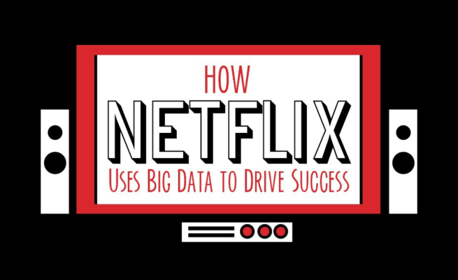
1309 Ye-won Shin
1502 Na-yun Kim

Slide 2

What is Netflix?
World’s leading internet entertainment service
Shows movies & invest in movies
Use Big data -> recommend movie
GPA
Movie style
Various recommendations
Recent purchase

Slide 3
Purpose of DATA MINING
By using Data mining, we could predict audience rating & the love of the public
Big data helps Netflix decide which programs will be of interest to users and the recommendation system actually influences 80% of the content we watch on Netflix.

Slide 4





How Netflix gathers big data
Date the movie/show was watched
GPA / ratings
Recent Search
When did they rewind/fast-forward?
When did they stop?

Slide 5



How Netflix gathers big data
On which device it is watched
Do portions of programs get re-watched
Do the credits get skipped
Do the nature of the shows watched vary depending on device

Slide 6
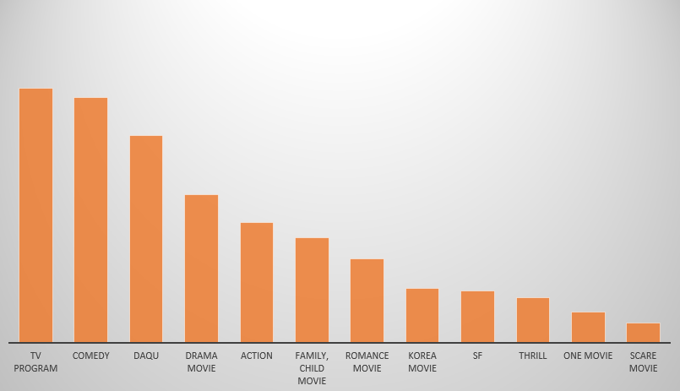
Result
To success -> Need two people (Kevin Spacey, David Fincher)
With Kevin Spacey, David Fincher, it can success easier
type of video that people Prefer

Slide 7
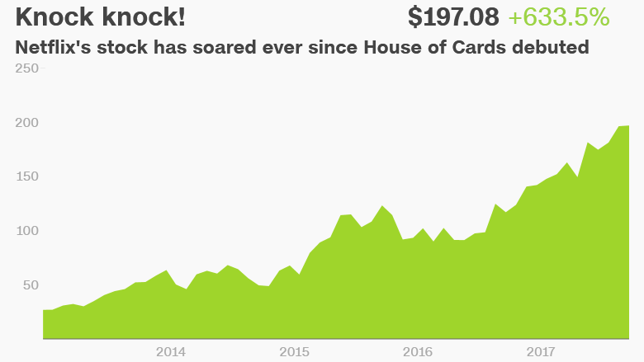
Before entering the house of cards, Netflix used user big data to select director David Fincher and lead actor Kevin Spacey.
By predicting the success of House of cards, Netflix made an investment of 10 billion dollars.

Slide 8
Process
S3
Designed for 99.999% durability and 99.99% availability of objects over a given year, and can sustain concurrent loss of data in two facilities.
Provides bucket versioning, which they use to protect against inadvertent data loss. If a developer errantly deletes some data, they can easily recover it.
Elastic, and provides practically “unlimited” size.

Slide 9
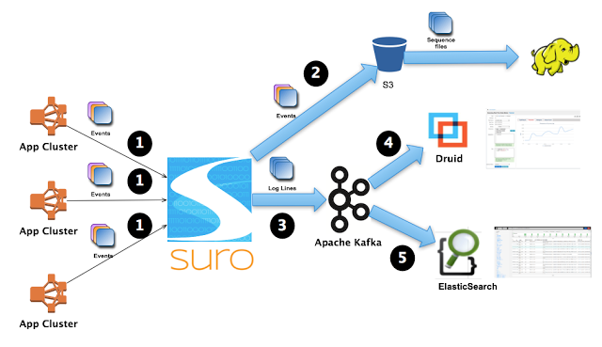
Process

Slide 10
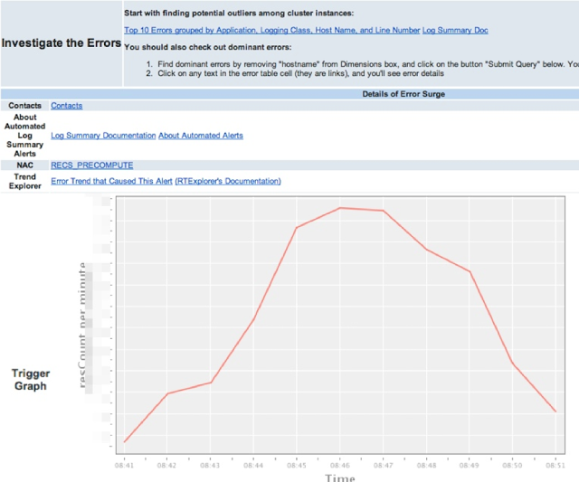
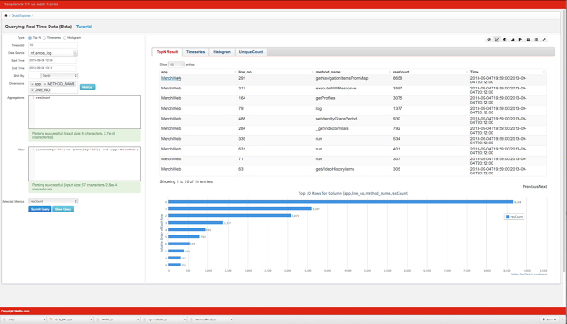
Process
Applications emits events to Suro. The events include log lines.
Suro dispatches all the events to S3 by default. Hadoop jobs will process these events.
Based on a dynamically configurable routing rule, Suro also dispatches these log events to a designated Kafka cluster under a mapped topic.
Druid cluster indexes the log lines on the fly, making them immediately available for querying. For example, our service automatically detects error surges for each application within a 10 minute window and sends out alerts to application owners:
5. Application owners can then go to Druid’s UI to explore such errors:

Slide 11
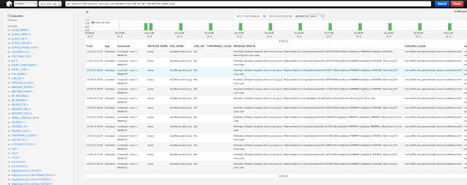
Process
6. A customized Elastic Search cluster also ingests the same sets of log lines, de-duplicates them, and makes them immediately available for querying. Users are able to jump from an aggregated view on the Druid UI to individual records on Elastic Search’s Kibana UI to see exactly what went wrong.

Slide 12
Process
Client buffers events in a buffer called message set, and sends buffered messages to Suro Collector.
Suro Collector takes each incoming message set, deflates it if possible, and immediately returns after handing the message set to Message Set Processor.
The Message Set Processor puts the message set into a queue, and has a pool of Message Router threads that routes messages asynchronously.
A Message Router determines which sink a message should go to. If there’s a filter configured for a message, the message payload will be deserialized.
Each sink maintains its own queue, and sends messages to designated configurations asynchronously.

Slide 13
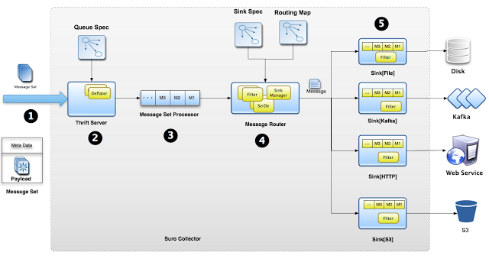
Process

